Slide 1

Inferences about Population Means

Slide 2

What is the main use of the t-test?
How is the distribution of t related to the unit normal?
When would we use a t-test instead of a z-test? Why might we prefer one to the other?
What are the chief varieties or forms of the t-test?
What is the standard error of the difference between means? What are the factors that influence its size?

Slide 3

Identify the appropriate to version of t to use for a given design.
Compute and interpret t-tests appropriately.
Given that
construct a rejection region. Draw a picture to illustrate.

Slide 4

The t-test is used to test hypotheses about means when the population variance is unknown (the usual case). Closely related to z, the unit normal.
Developed by Gossett for the quality control of beer.
Comes in 3 varieties:
Single sample, independent samples, and dependent samples.

Slide 5

Single sample t – we have only 1 group; want to test against a hypothetical mean.
Independent samples t – we have 2 means, 2 groups; no relation between groups, e.g., people randomly assigned to a single group.
Dependent t – we have two means. Either same people in both groups, or people are related, e.g., husband-wife, left hand-right hand, hospital patient and visitor.

Slide 6
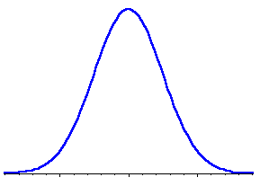
Hypotheses
  H₀ = Null-hypothesis
  H₁ = experimental/ research hypothesis
Descriptive vs inferential statistics
(Gaussian) distributions
p-value & alpha-level (probability and significance)
Notes:
Experimental hypothesis is essentially a prediction that you have about a set of data/ an event/ a group/ a topic and this prediction must be falsifiable.
Usually, an experiment is aimed at disproving that null-hypothesis is true.
Null-hypothesis is the opposite of the experimental condition; usually you expect a difference/ an effect in your experiment, thus the null-hypothesis claims that this effect does not exist.
With regards to fMRI, this would relate to activation being expected and observed, or, if Null-hypothesis is true, then not.
Example: activation in the left occipitotemporal regions , esp the visual word form area (VWFA), is greatest for written words (visual word forms).
See Cohen and Dehaene (2004) NeuroImage
Descriptive stats:
Allow to summarise data (which is huge amounts of numbers essentially)
Allows one to grasp the essential features of data (quickly and easily)
Often in image form
Mean, median, mode, SDs, histograms, etc
Inferential* stats:
Goes beyond the pure data
Informs about likelihood of the findings, ie about the probability that findings would turn out they way they actually have, ie if effects are genuine and due to experimental manipulation ot occur simply by chance
Inferential stats is possible because research data is rarely random (ie there usually is a similar pattern in distribution)
2 types: distribution tests (t-tests and ANOVAs) and correlation tests
* inference: the act or process of deriving a conclusion based on what one already knows
VWFA example:
activation in the VWFA is present when
- reading is compared to a rest condition or false fonts (unknown script),
OR
- when pictures of objects are named (eg, tiger) relative to resting condition,
OR
- when picture naming is compared to reading aloud those exact object labels (eg, naming the picture of a tiger versus reading the word “tiger”),
OR
- when colours are named,
OR
- when an action associated with an object (shown as a picture) is carried out (eg, moving fingers quickly along an imaginary board to illustrate touch typing when presented with a picture of a touch typing machine),
OR
- when “reading” Braille with abstract meaning,
OR
- when seeing novel objects (previously unknown and thus without any kind of word label attached to it)
BOLD signal intensity can be measured for these conditions and the values can be listed (the number crunching = descriptive stats)
But the question really is: if there is a numerical difference in these values, is this difference meaningful?
Inferential stats can tell you!
Probability
Relates to the probability of the null-hypothesis being true
Expressed as a positive decimal fraction, eg
.1 (1/10)
.05 (5/100)
.01 (1/100)
Probability can never be higher than 1 because probability of 1 means that something happened every single time
Expressed as p-value (a simple numerical number)
Significance (alpha-level)
Closely related to probability; significance levels inform whether differences or correlations found in the data are actually important or not
Even though probability may be small, the effect may not necessarily be important whereas very small effects can turn out to be statistically significant (the latter is often true for huge sample sizes, esp in medical research)
Expressed as p-value; often set at P < .05 (even though that may depend, esp in fMRI often lower)
Attaching statistical meaning to a numerical number; significance levels have LOW probabilities expressed in p-values
If p < α level then we reject the null hypothesis and accept the experimental hypothesis
- concluding that we are 95% certain that our experimental effect is genuine
If however, p > α level then we reject the experimental hypothesis and accept the null hypothesis as true
- that there was no sig diff in brain activation levels between the two conditions (that you are comparing)

Slide 7



Population
⇨ z-tests and distributions
Sample
(of a population)
t-tests and distributions
NOTE: a sample can be 2 sets of scores, eg fMRI data from 2 conditions
Notes:
Populations require z-tests
Samples require t-tests
General: hypothesis testing relates to POPULATIONS, not samples. Because we usually only test/ study samples, we need to use sample means in order to infer to population means. T-distribution has to be used for samples (this is similar to z-distributions in that it is symmetrical but flatter and changes with sample size).
Z-tests and tables: used with normally distributed population data (see above)
T-tests and tables: used with normally distributed sample data

Slide 8


Are these groups different?
Notes:
Usually, you only have access to samples which means you never capture a population as a whole
Need to be careful that your samples is representative of your population

Slide 9


Compare the mean between 2 samples/ conditions
if 2 samples are taken from the same population, then they should have fairly similar means
⇨ if 2 means are statistically different, then the samples are likely to be drawn from 2 different populations, ie they really are different
Notes:
assesses whether the means of two samples are statistically different from each other. This analysis is appropriate whenever you want to compare the means of two samples/ conditions
mean
arithmetic average
a hypothetical value that can be calculated for a data set; it doesn’t have to be a value that is actually observed in the data set
calculated by adding up all scores and dividing them by number of scores
assumptions of a t-test:
from a parametric population
not (seriously) skewed
no outliers
independent samples

Slide 10

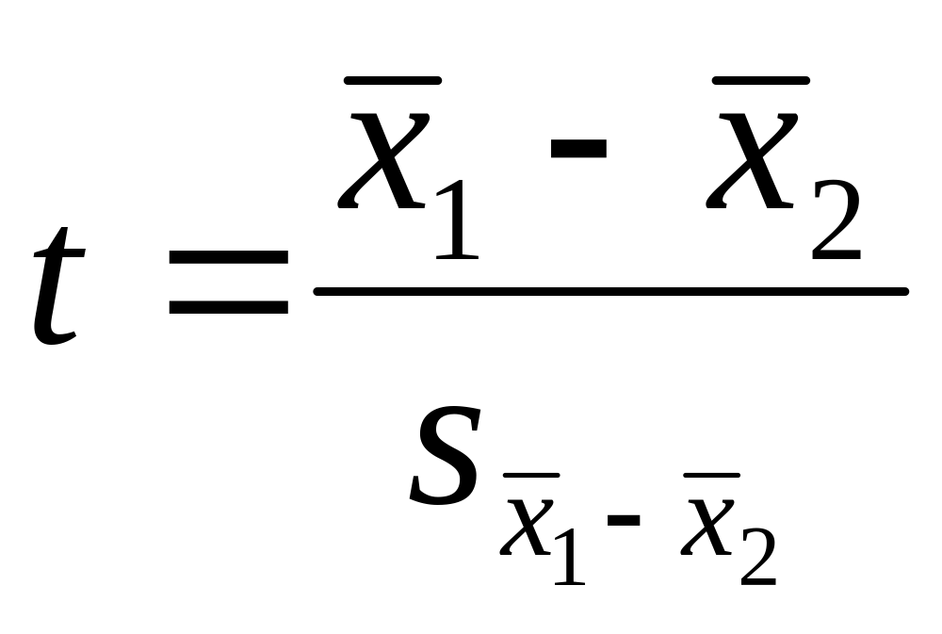
Difference between the means divided by the pooled standard error of the mean
Reporting convention: t= 11.456, df= 9, p< 0.001
Notes:
t-value+ an end product of a calculation
df = degrees of freedom (the number of individual scores that can vary without changing the sample mean)
Standard error
Is the standard deviation of sample means
It is a measure of how representative a sample is likely to be of the population
Large SE (relative to the sample mean): lots of variability between means of different samples ⇨ used sample may not be representative of a population
Small SE: most sample means are similar to the population mean ⇨ sample is likely to be an accurate reflection of the population

Slide 11

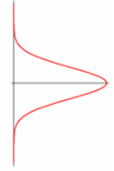
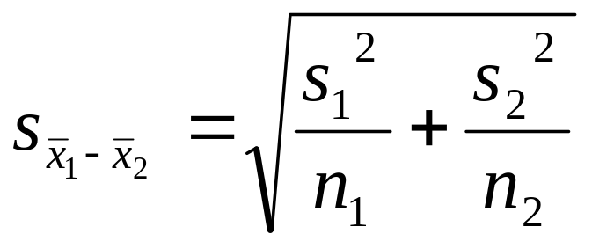
Cond. 1
Cond. 2
Notes:
I admit I stole this from last year’s presentation: you may read this at your own leisure ☺
To calculate the t score,
Take mean from condition 1 (x bar)
Then the mean from condition 2
Find the difference between these two
And divide this by their shared standard error
Calculate this by…
Taking the variance for group 1 and dividing it by the sample size for this group
Do the same for group 2 and add together.
Then finally take the square root of this and put the resulting value back into the original calculation to get your t value.

Slide 12




 | Independent Samples | Related Samples also called dependent means test
Interval measures/ parametric | Independent samples t-test* | Paired samples t-test**
Ordinal/ non-parametric | Mann-Whitney U-Test | Wilcoxon test
* 2 experimental conditions and different participants were assigned to each condition
** 2 experimental conditions and the same participants took part in both conditions of the experiments
Notes:
There are lots of different types of t-tests, which need to be used depending on the type of data you have
(equal) interval measures
Scales in which the difference between consecutive measuring points on the scale is of equal value throughout
No arbitrary zero, ie positive and negative measures, eg temperature
Ordinal measures
Scales on which the items can be ranked in order
There is an order of magnitude but intervals may vary, ie one item on the scale is more or less than another but it is not clear by how much as this cannot be measured
Often statements/ feelings are attached to numbers which can then be used for rating; in fact, this data can only be ranked (from highest to lowest) , ie what score had the highest turn-out
1= very good, 2= good, 3= neutral, 4= bad, 5= very bad
Different measurements have a direct influence on the way analysis is conducted because some of them are more amenable to mathematical operations than others

Slide 13

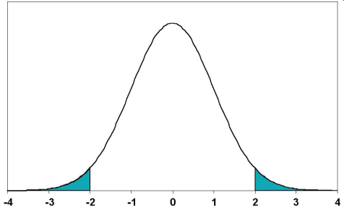


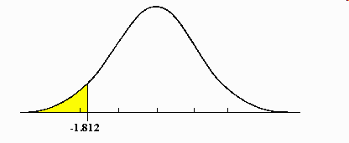
2-tailed tests vs one-tailed tests
2 sample t-tests vs 1 sample t-tests
2.5%
2.5%
Mean
Mean
A known value
Mean
5%
Notes:
2-tailed tests vs one-tailed tests
If you set alpha-level at 0.05, there is 5% “area” in which a score would fall (outside where it is expected)
2-tailed tests leave room for this area to occur on both extreme ends, ie improvement may be either positive or negative (ie, 2,5% at either end)
One-tailed tests deny this and assume that the 5% can only occur at one extreme end (5%)
Both tails are meaningful in behavioural studies and should be favoured
2 sample t-tests vs 1 sample t-tests
2 sample t-tests compare the mean of 2 samples (both means are measured within the experiment)
1 sample t-tests compare the mean of one sample to a known value, often a (previously known) population mean
In fMRI: compare either 2 activation means of 2 different groups to each other or see if your one sample reaches a level of activation that you are expecting given some prior knowledge

Slide 14

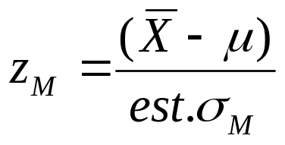
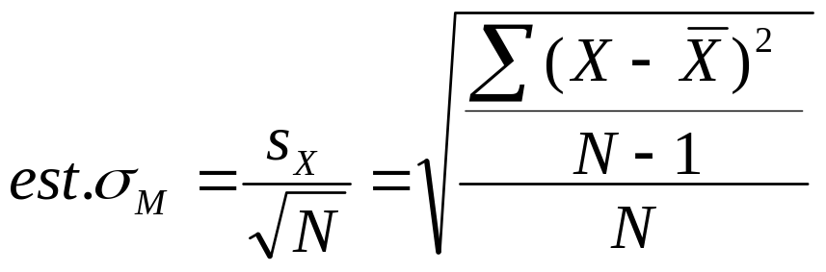
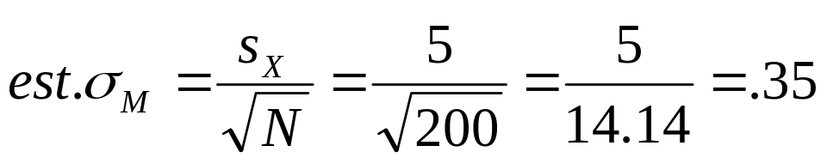
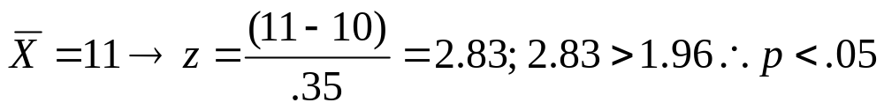
For large samples (N>100) can use z to test hypotheses about means.
Suppose
Then
If

Slide 15

For the t distribution, degrees of freedom are always a simple function of the sample size, e.g., (N-1).
One way of explaining df is that if we know the total or mean, and all but one score, the last (N-1) score is not free to vary. It is fixed by the other scores. 4+3+2+X = 10. X=1.

Slide 16

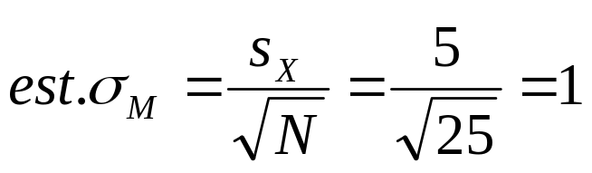
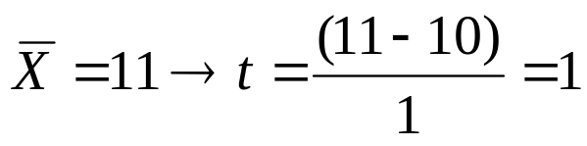

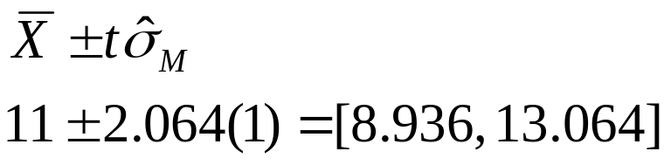
With a small sample size, we compute the same numbers as we did for z, but we compare them to the t distribution instead of the z distribution.
(c.f. z=1.96)
1<2.064, n.s.
Interval =
Interval is about 9 to 13 and contains 10, so n.s.

Slide 17

How are the distributions of z and t related?
Given that
construct a rejection region. Draw a picture to illustrate.

Slide 18
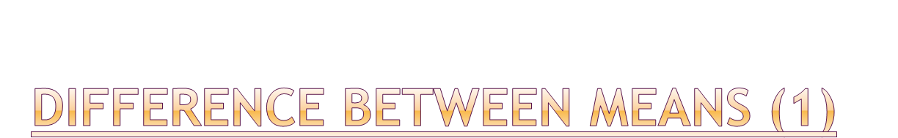

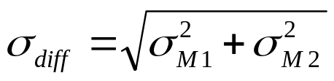
Most studies have at least 2 groups (e.g., M vs. F, Exp vs. Control)
If we want to know diff in population means, best guess is diff in sample means.
Unbiased:
Variance of the Difference:
Standard Error:

Slide 19
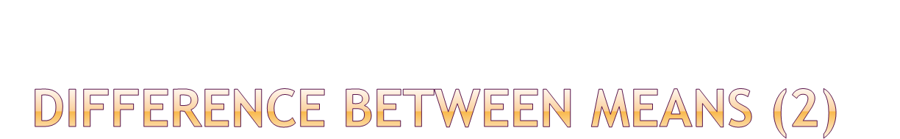
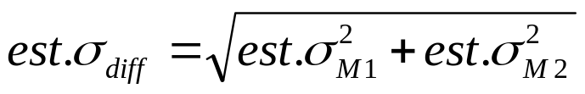
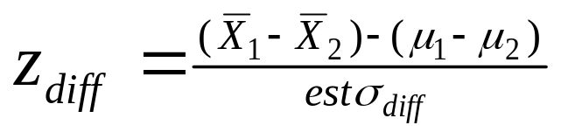
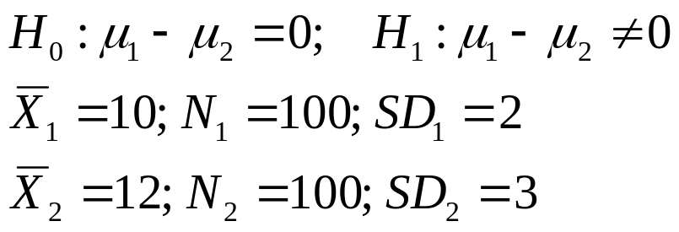
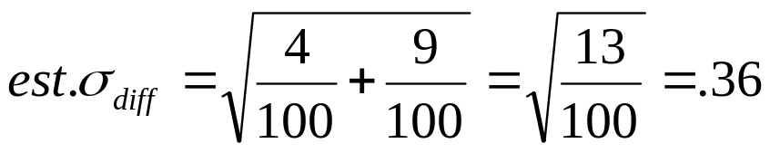
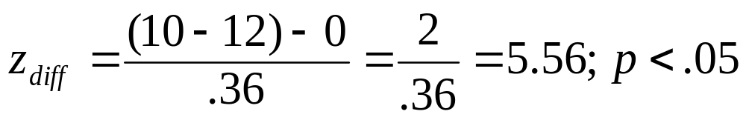
We can estimate the standard error of the difference between means.
For large samples, can use z

Slide 20

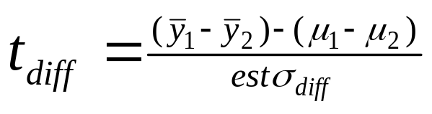
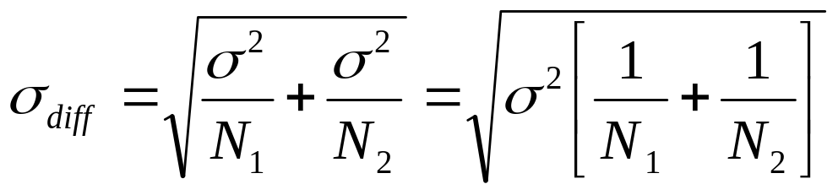
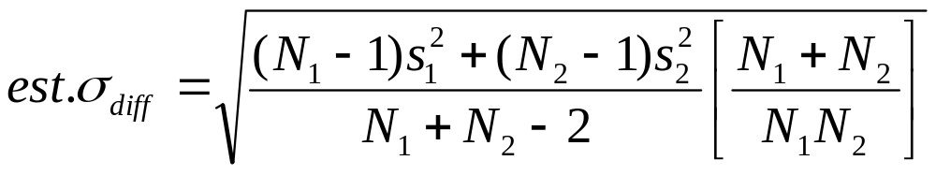
Looks just like z:
df=N₁-1+N₂-1=N₁+N₂-2
If SDs are equal, estimate is:
Pooled variance estimate is weighted average:
Pooled Standard Error of the Difference (computed):

Slide 21

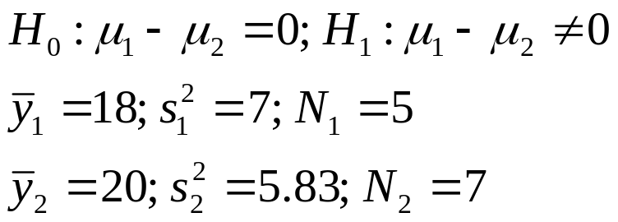
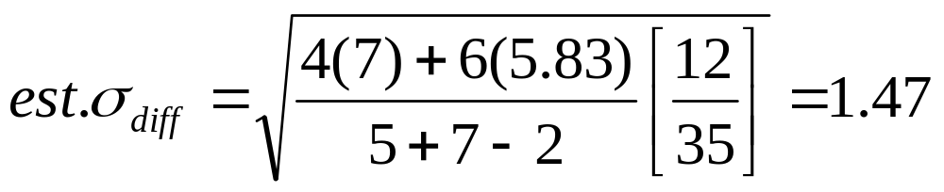
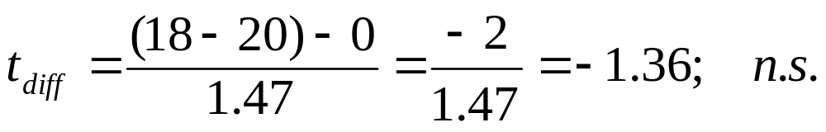
t_{crit} = t(.05,10)=2.23

